Slide 1
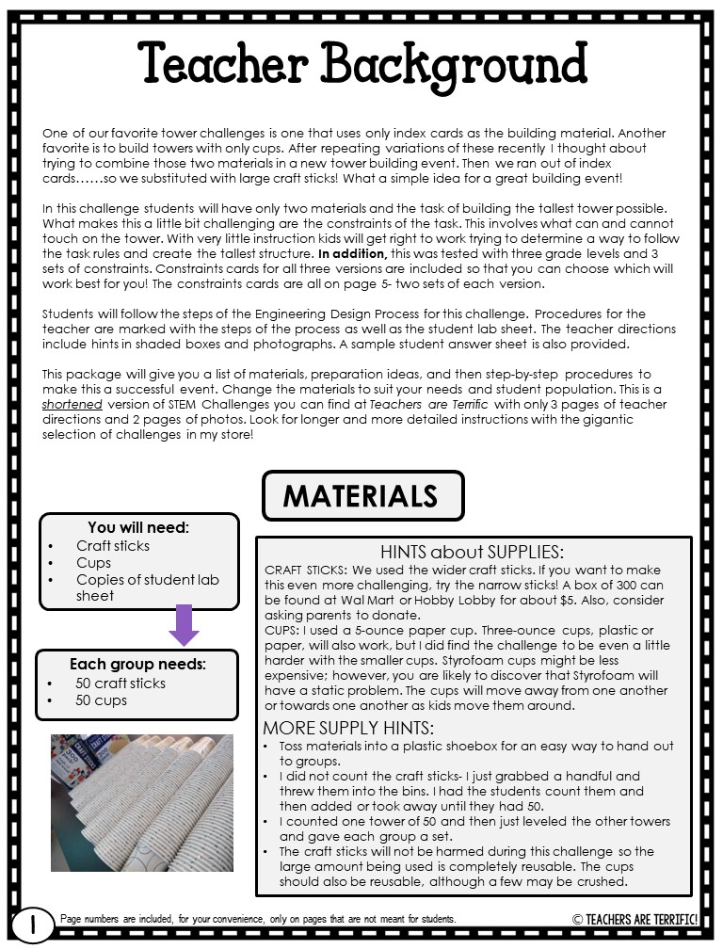
TO EDIT: You will need to click on the enable editing button at the top of the task bar!
PRINTING TIP:
Teachers- This file is in PowerPoint format. The backgrounds are embedded to protect my copyright. When you print this resource, you may need to save it as a PDF FIRST. Sometimes, printers will exclude the backgrounds that are embedded, and your printed pages will be blank.
AFTER EDITING THE EDITABLE PAGES SAVE THE FILE AS A PDF AND THEN PRINT!

Slide 2
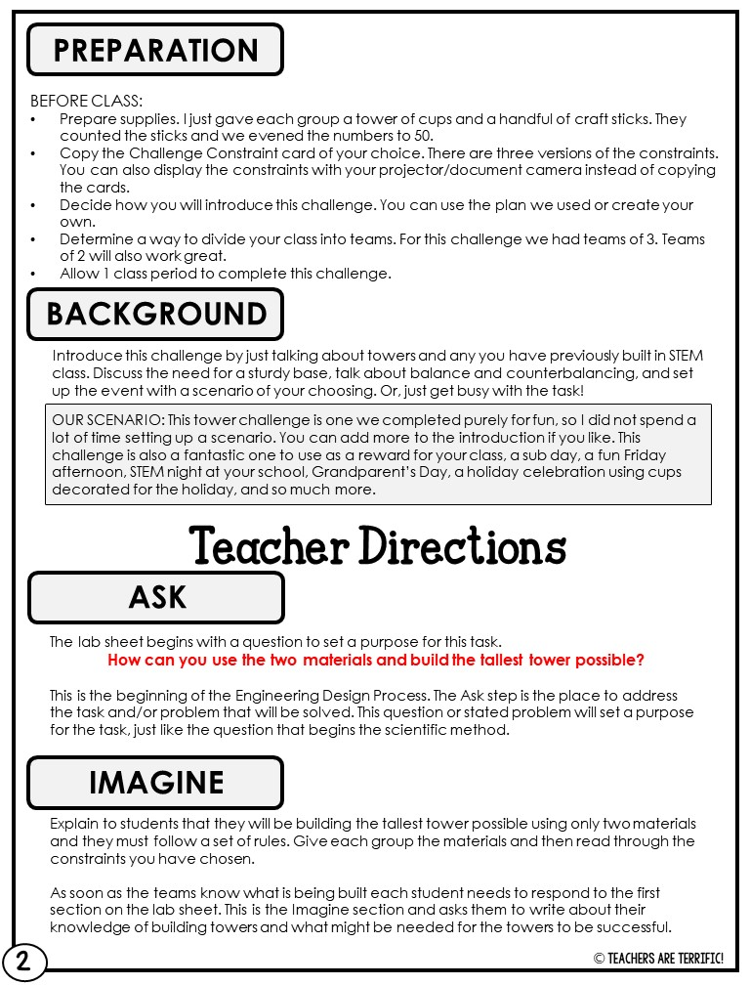

Slide 3
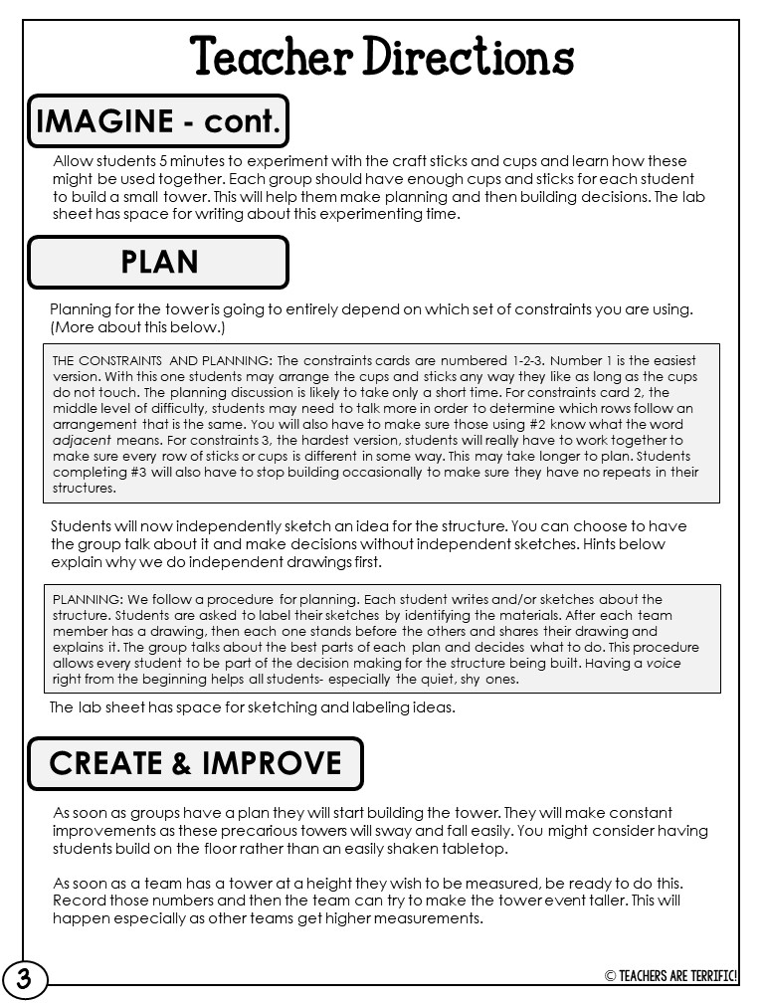

Slide 4
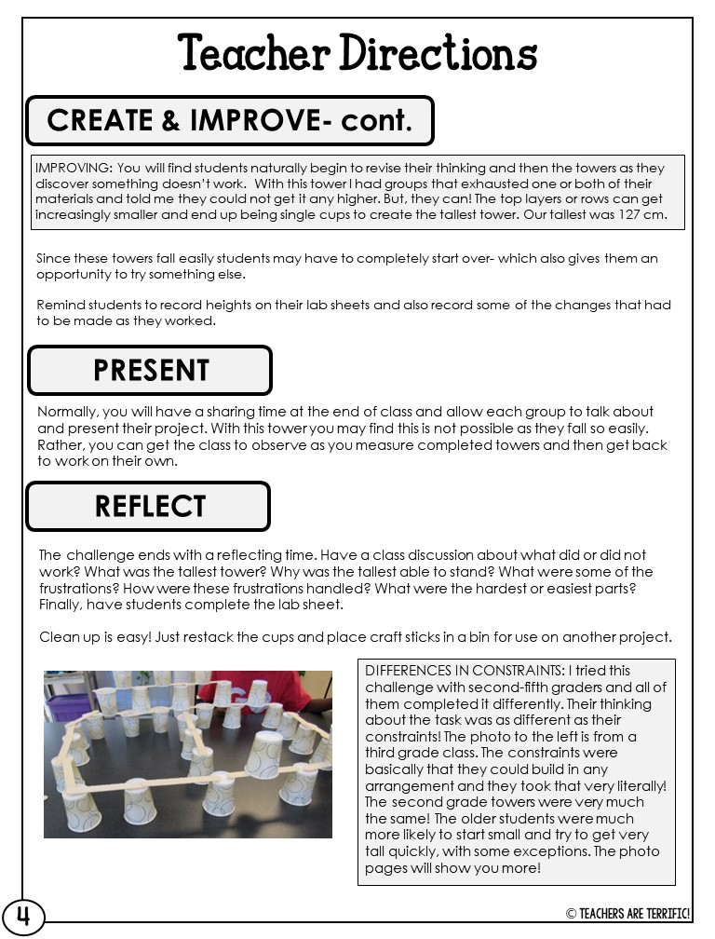

Slide 5
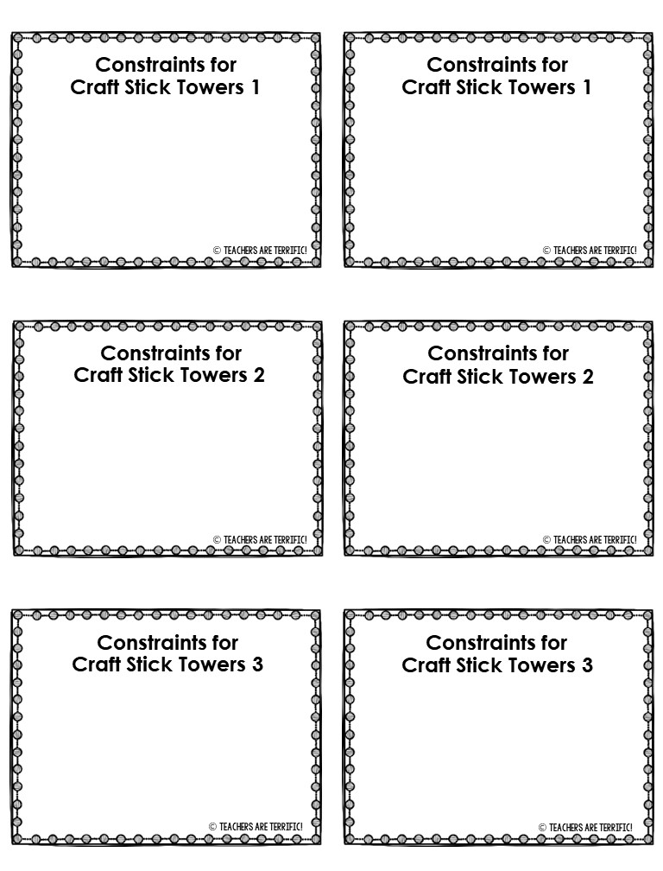
The titles and requirements for each challenge can be changed. Just click on the text and type what you need!
Delete this post-it note and arrows before printing!
The cups cannot touch each other.
Rows of cups and sticks can look the same.
The cups cannot touch each other.
Rows of cups and sticks can look the same.
The cups cannot touch each other.
Adjacent rows of cups and sticks cannot look the same.
The cups cannot touch each other.
Adjacent rows of cups and sticks cannot look the same.
The cups cannot touch each other.
Rows of cups and sticks must all look different.
The cups cannot touch each other.
Rows of cups and sticks must all look different.

Slide 6
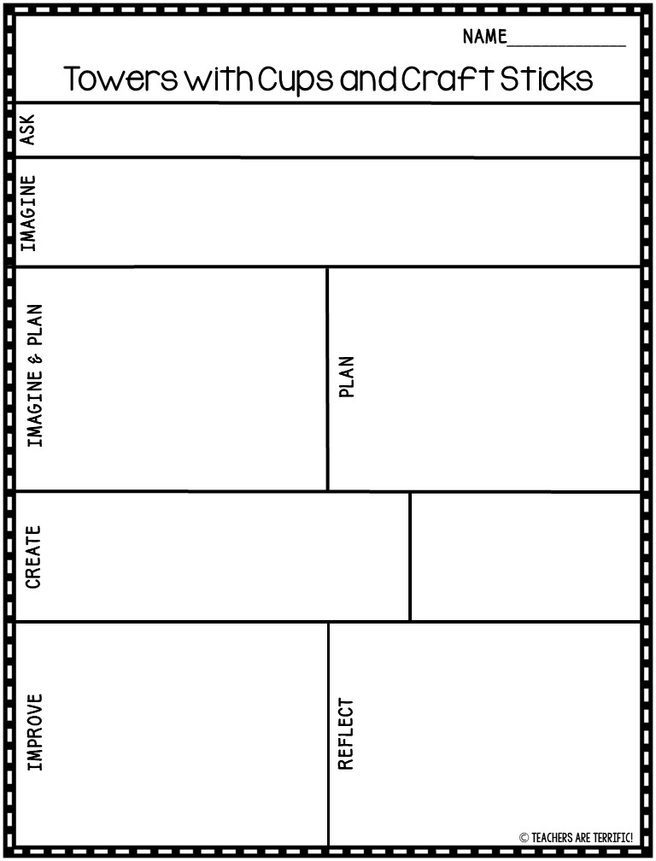
The specific wording of questions can be edited. You can also remove the lines if you like.
Delete this post-it note and the arrows before printing!
How can you use the two materials and build the tallest tower possible?
What are some things you will need to remember about building towers?
_________________________________________________________________________________________________________________________________________________________________________________________________________________________________________________________
Describe the experimenting that your team did as part of the planning step.
Sketch and label your idea for structure.
________________________________________________________________________________________________________________________________________________________________________________________________________________________________________________________________________________________________
Describe one way you worked together to build the tower.
Record any height measurements of your tower.
____________________________________________________________________________________________________________________________________________________________________________________________________
What changes did you have to make in order to build the tower?
Describe this building experience. What was the hardest part? What was your favorite part?
________________________________________________________________________________________________________________________________________________________________________________________________________________________________________________________________________________________
________________________________________________________________________________________________________________________________________________________________________________________________________________________________________________________________________________________

Slide 7
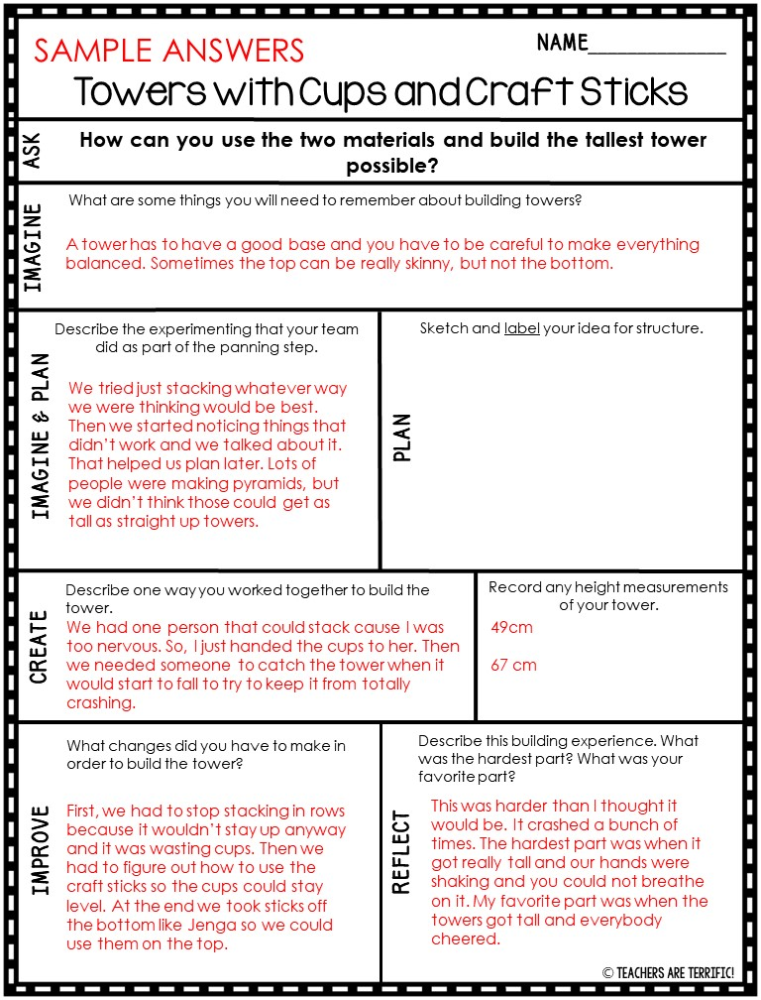

Slide 8
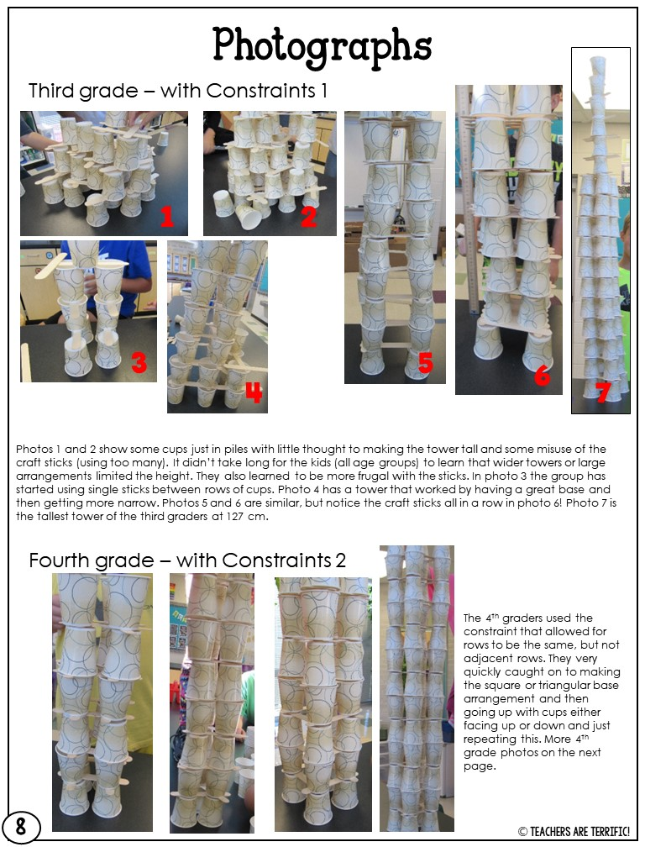

Slide 9
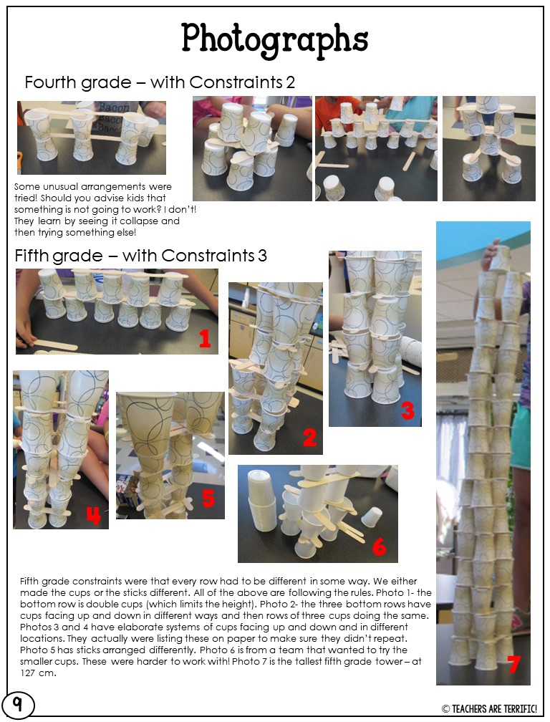

Slide 10
