Slide 1
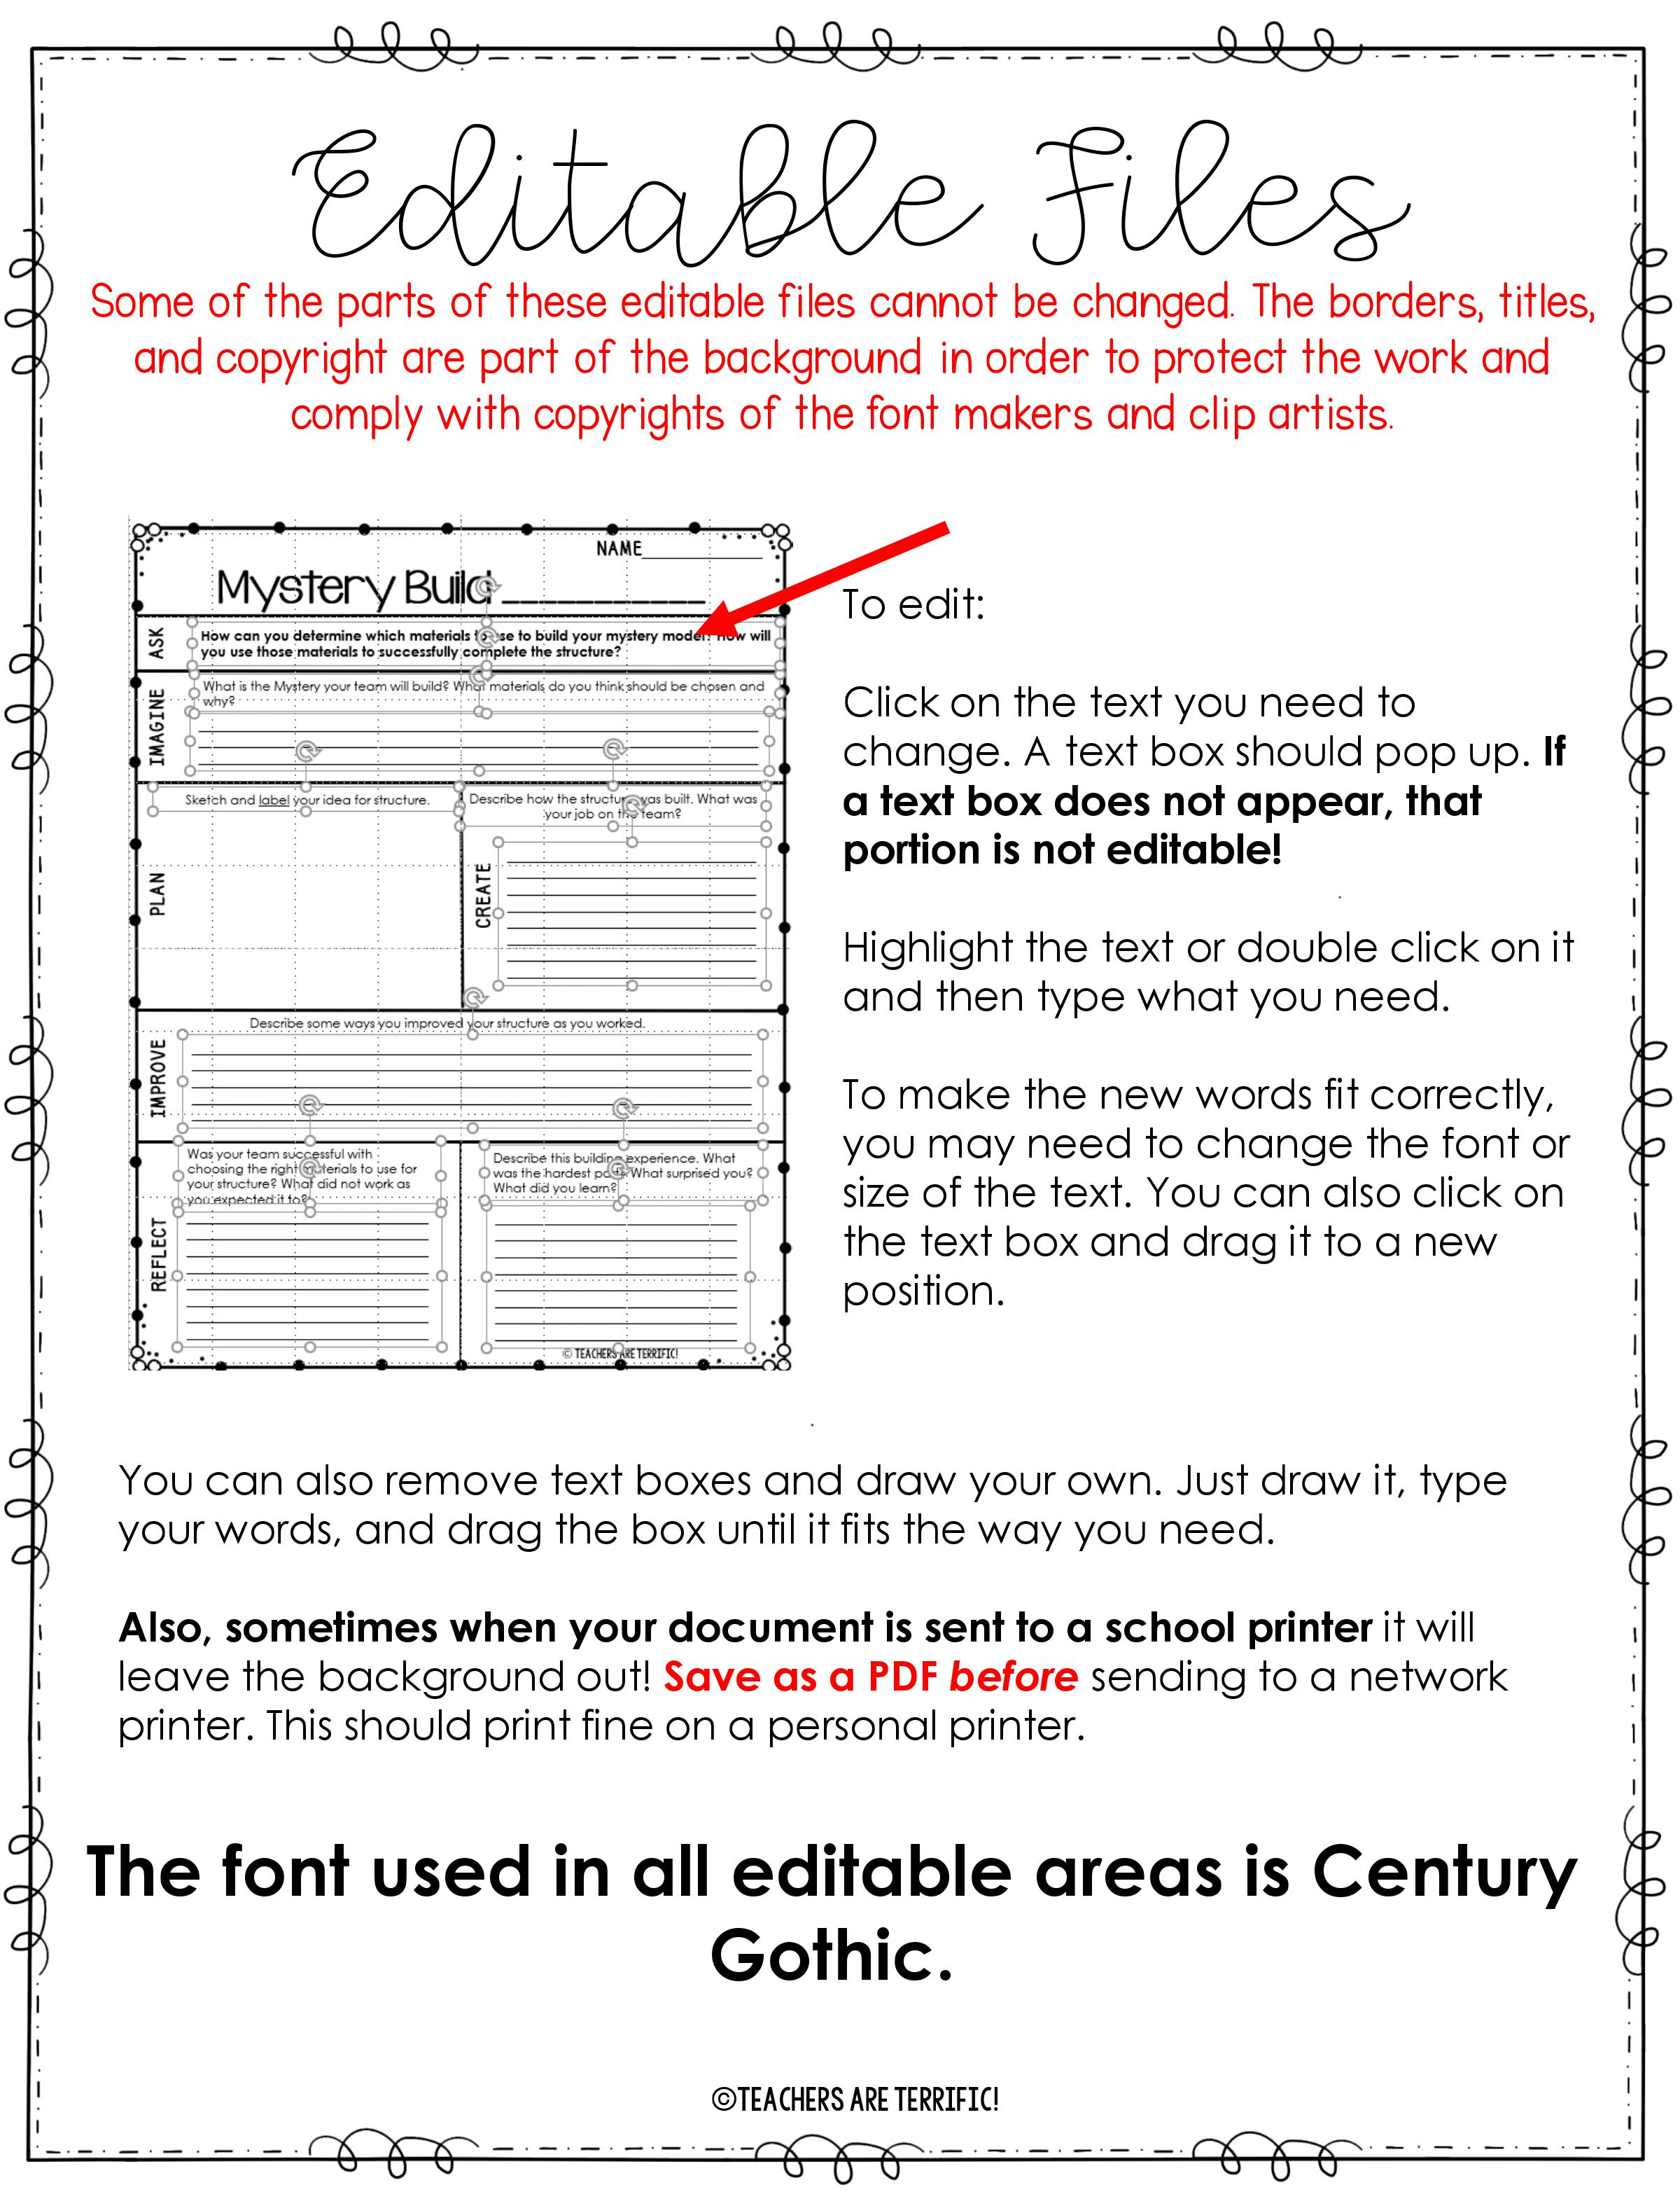

Slide 2
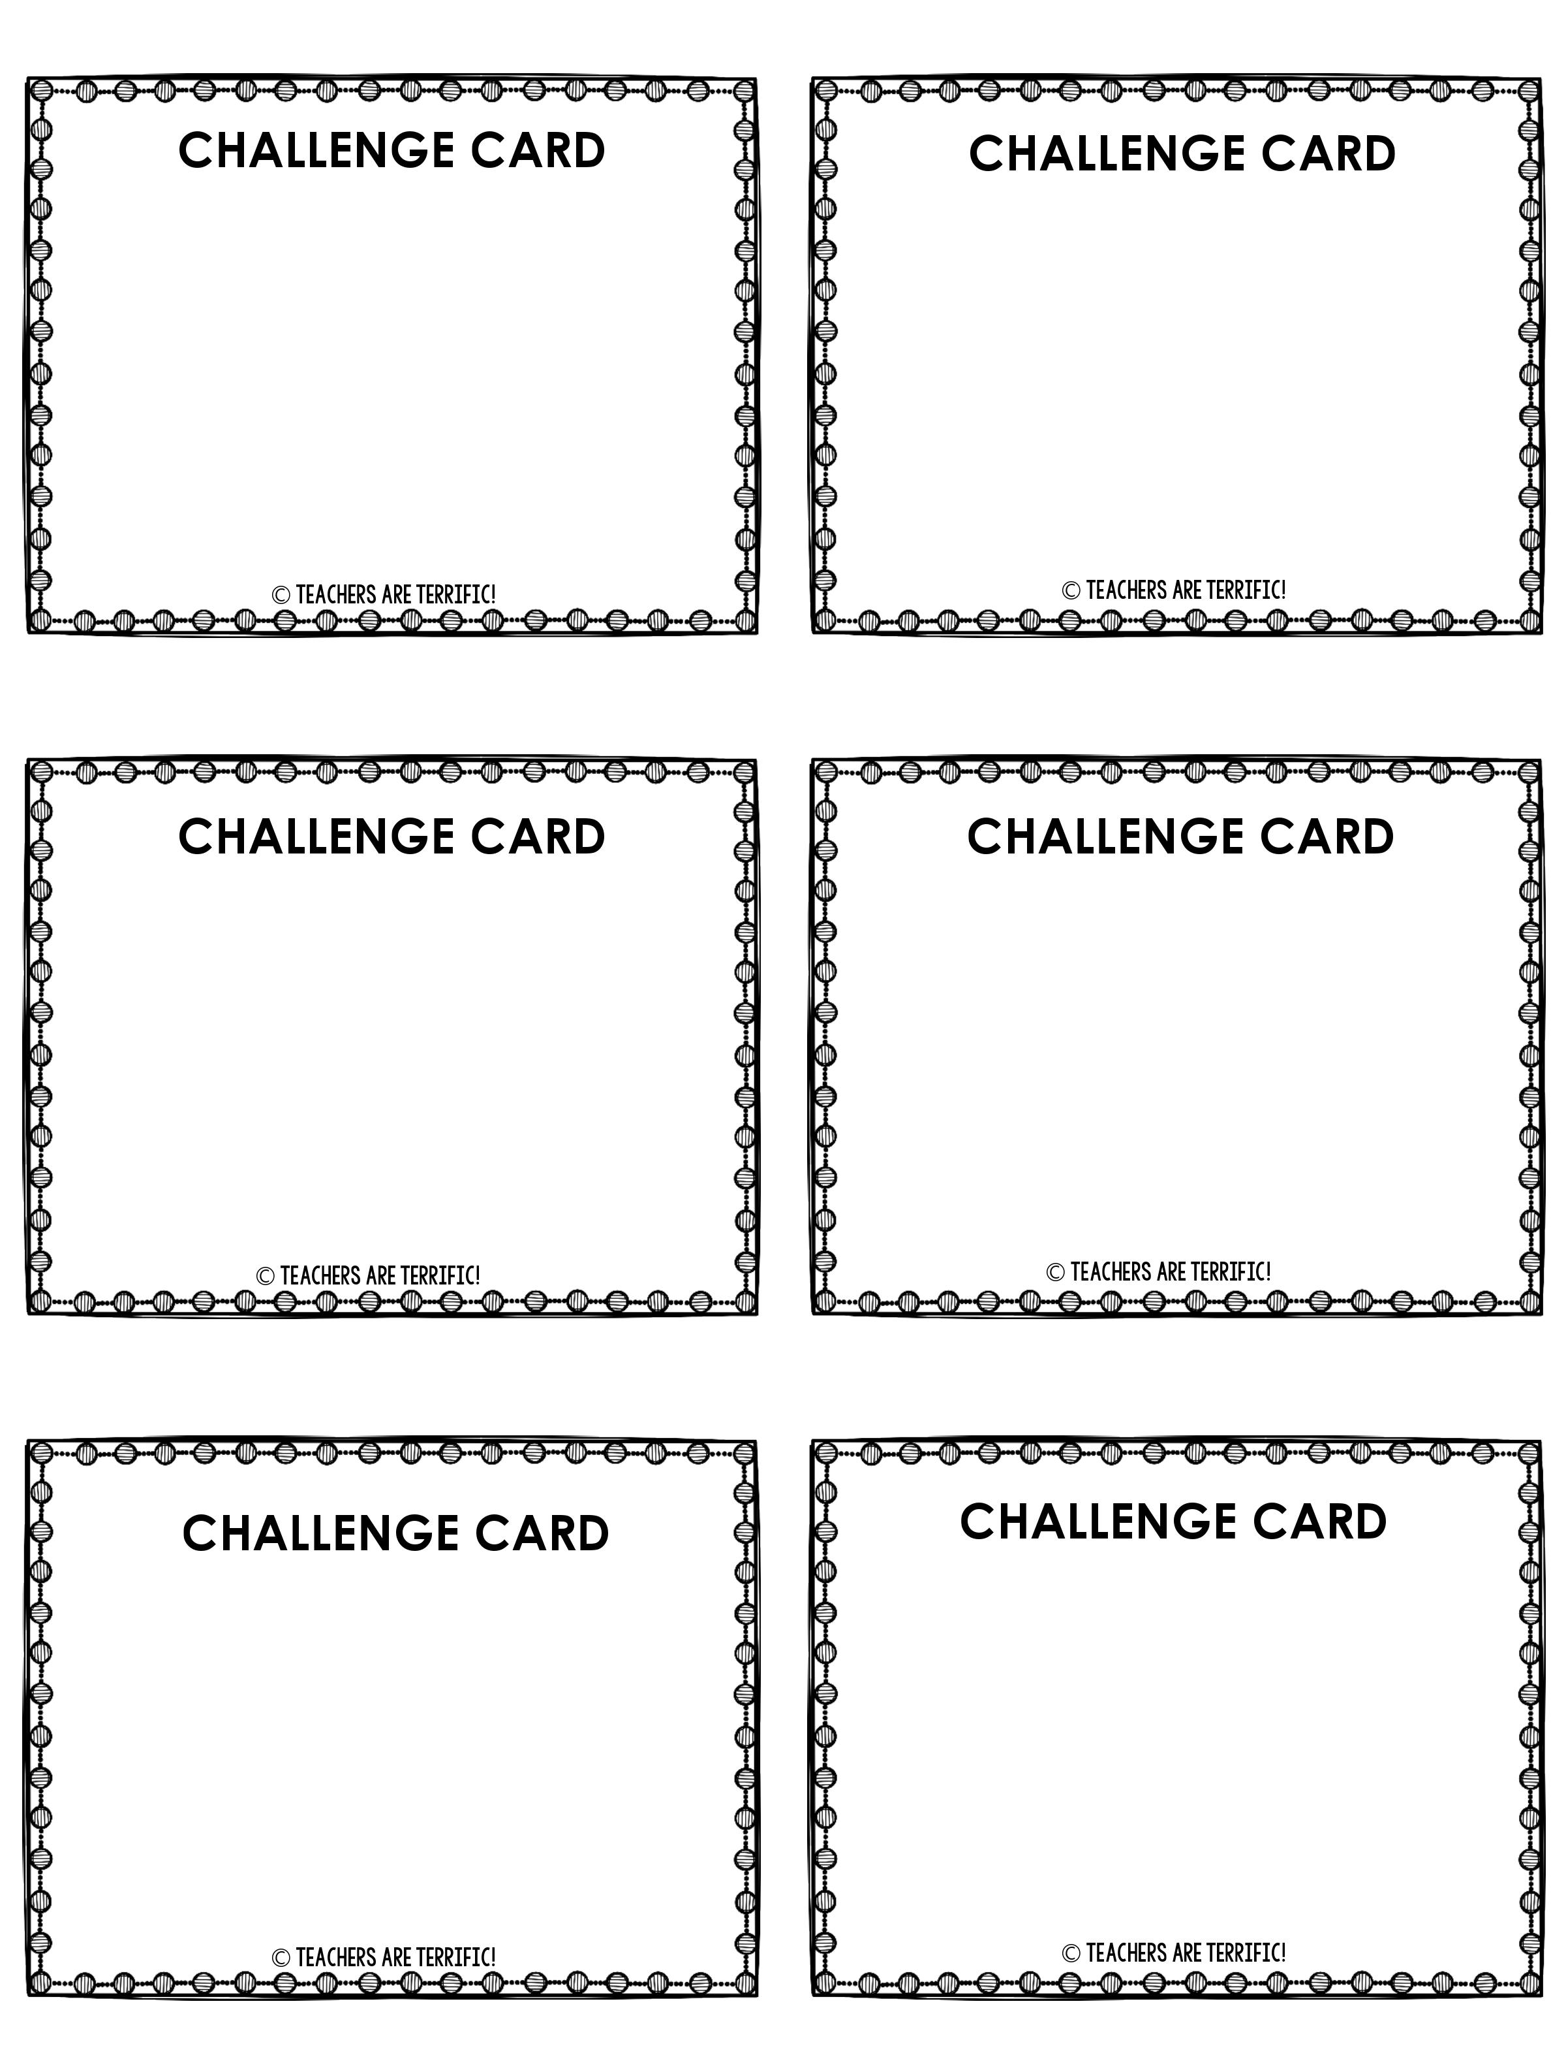
Build a Tower
Build a Rocking Chair
It must be at least 20 cm tall.
It must have 4 or more legs.
It must hold a bowl of pennies at the top.
It must be at least 20 cm tall.
It must rock!
The seat must hold a bowl of at least 20 pennies.
Build a Rocket
Build a Bridge
It must be at least 25 cm tall.
It must resemble a rocket.
It must have wings.
It must stand alone.
The bridge opening must be at least 10 cm wide.
It must have end supports.
It cannot have a center support.
It must hold a bowl of at least 20 pennies.
Build a Swing Set
Build a Small Marble Run
It must be at least 15 cm tall.
It must have a seat or container that freely swings.
The seat must securely hold a small toy figure.
The marble run will resemble a roller coaster.
It must have a turn or curve in it.
A marble must travel the path.
It must have one tunnel.

Slide 3
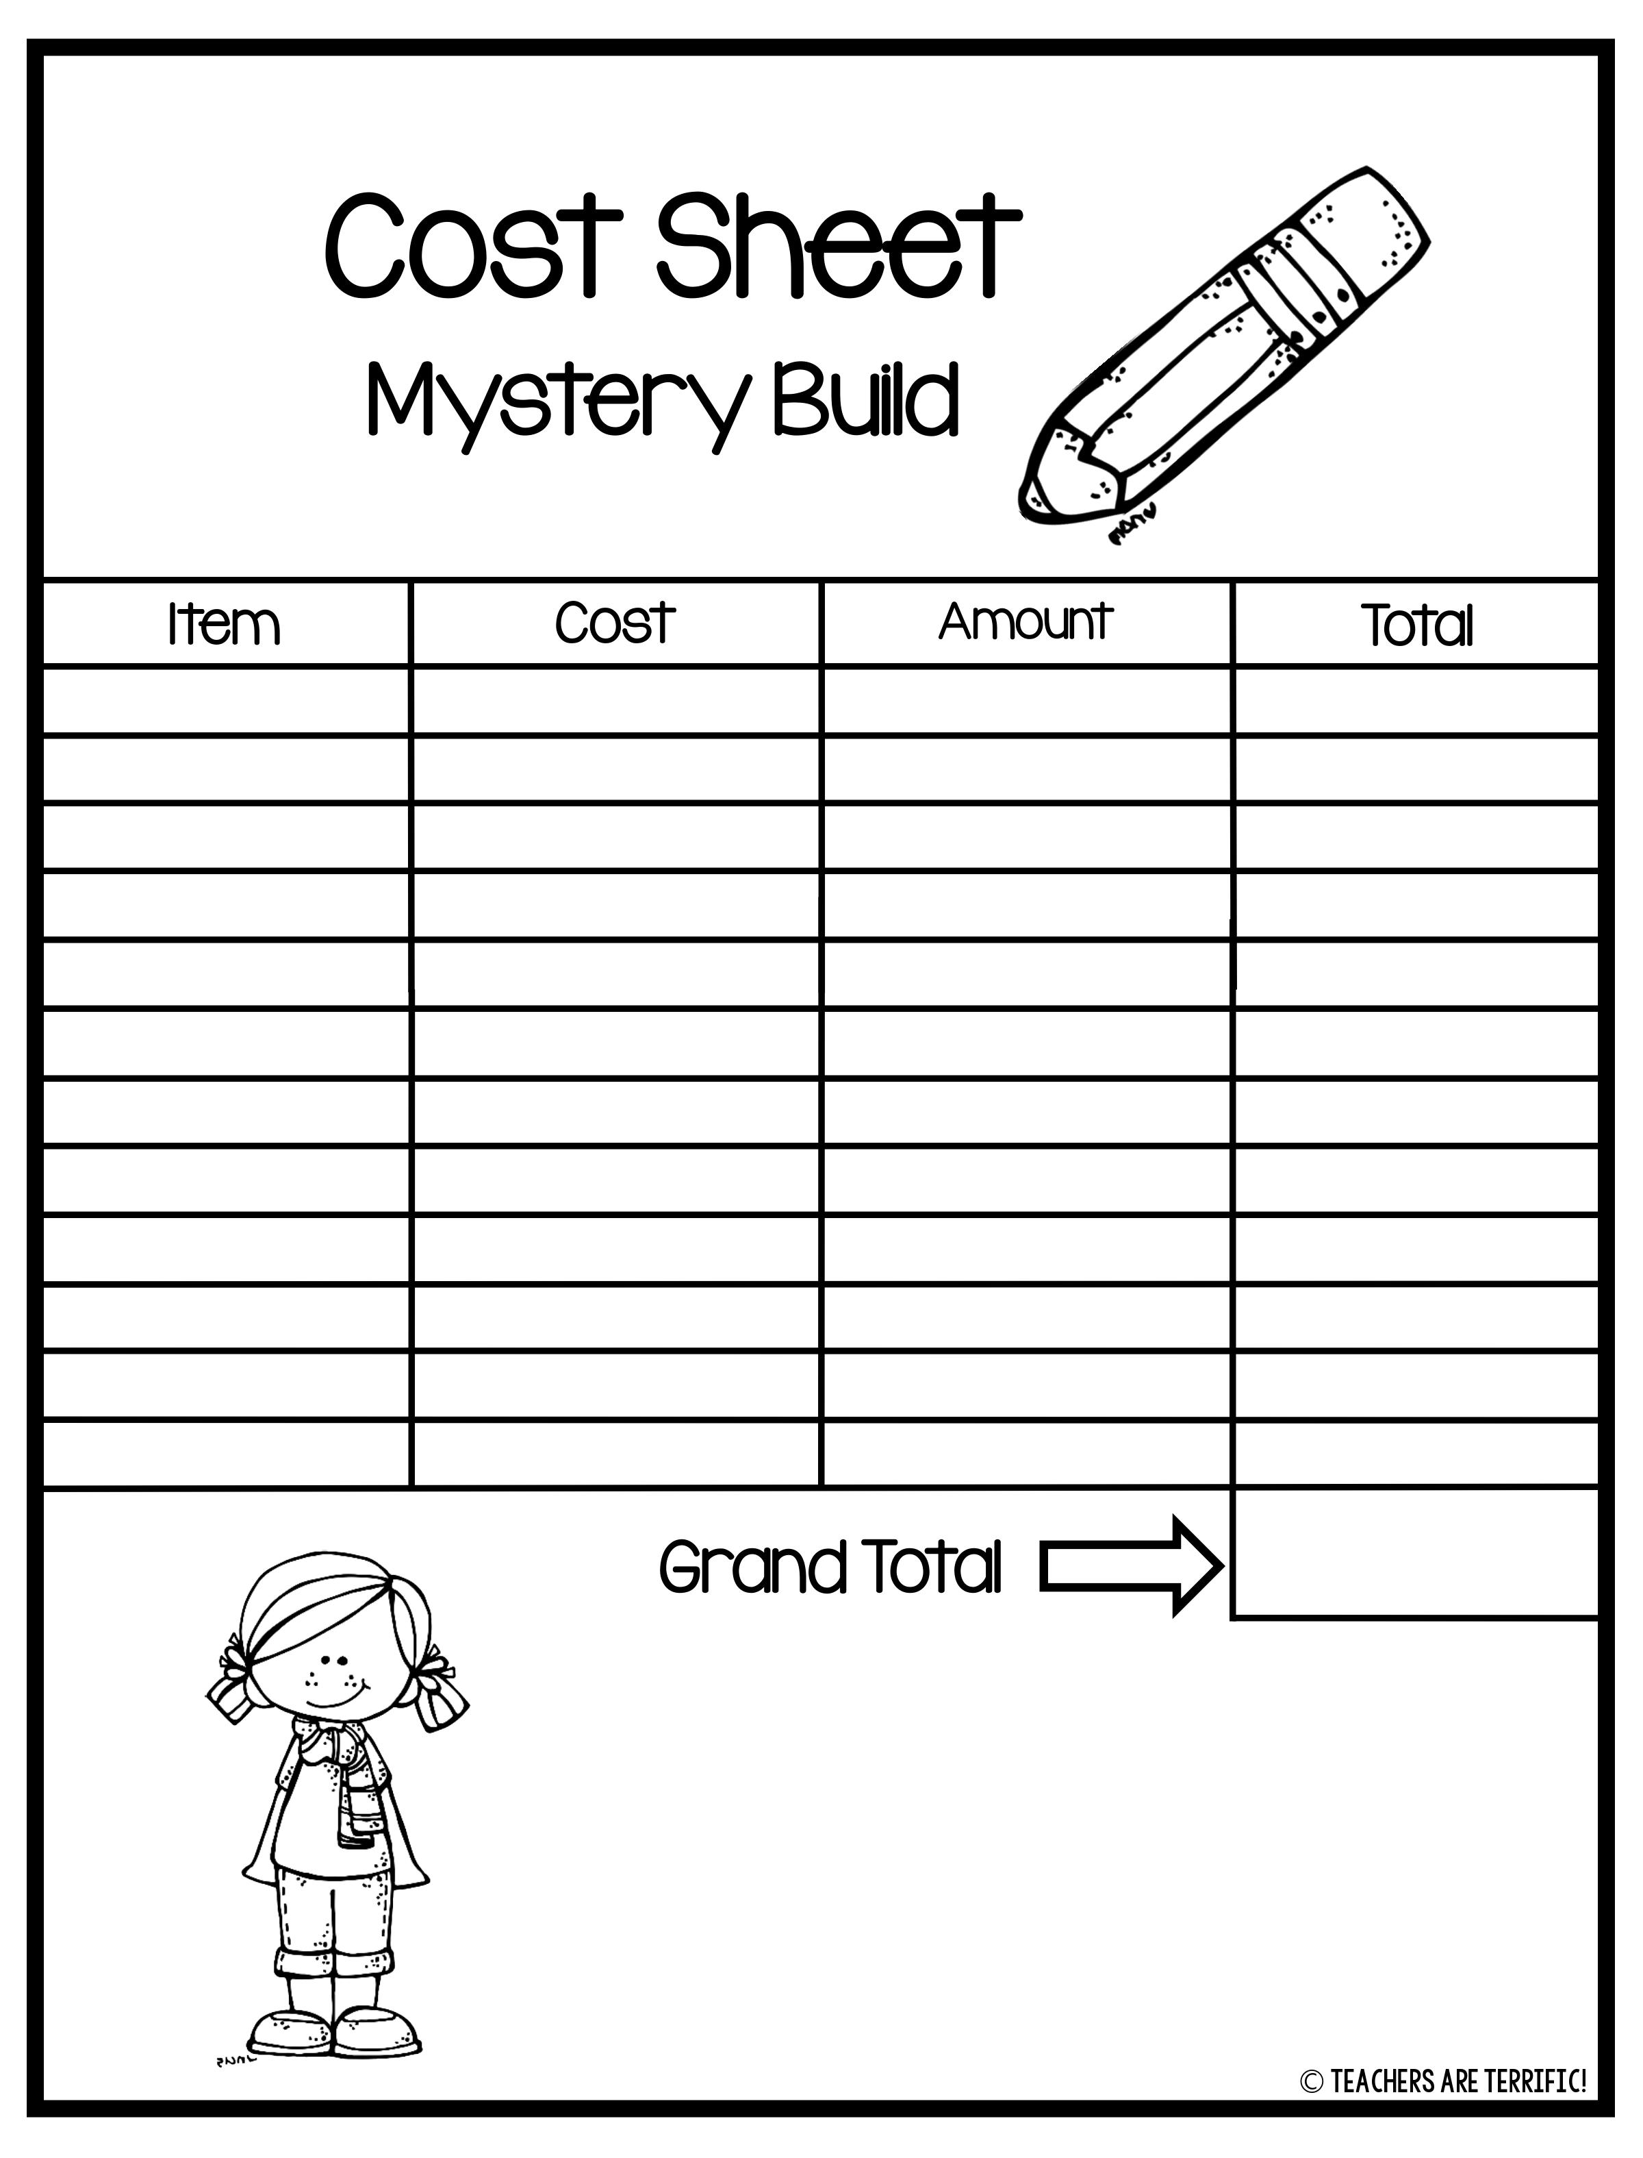
Craft Sticks
50¢ each
Paper Clips
10¢ each
Rubber Bands
10¢ each
Tubes
$2.00
Small Cup
$1.00
Large Cup
$2.00
Straws
10¢ each
Craft Foam
$1.00 each
Foil- 12 inches
$2.00
Toothpicks
10¢ each
Pipe cleaner
$1.00 each
Card stock
$1.00 each
The Budget is $10.00.

Slide 4
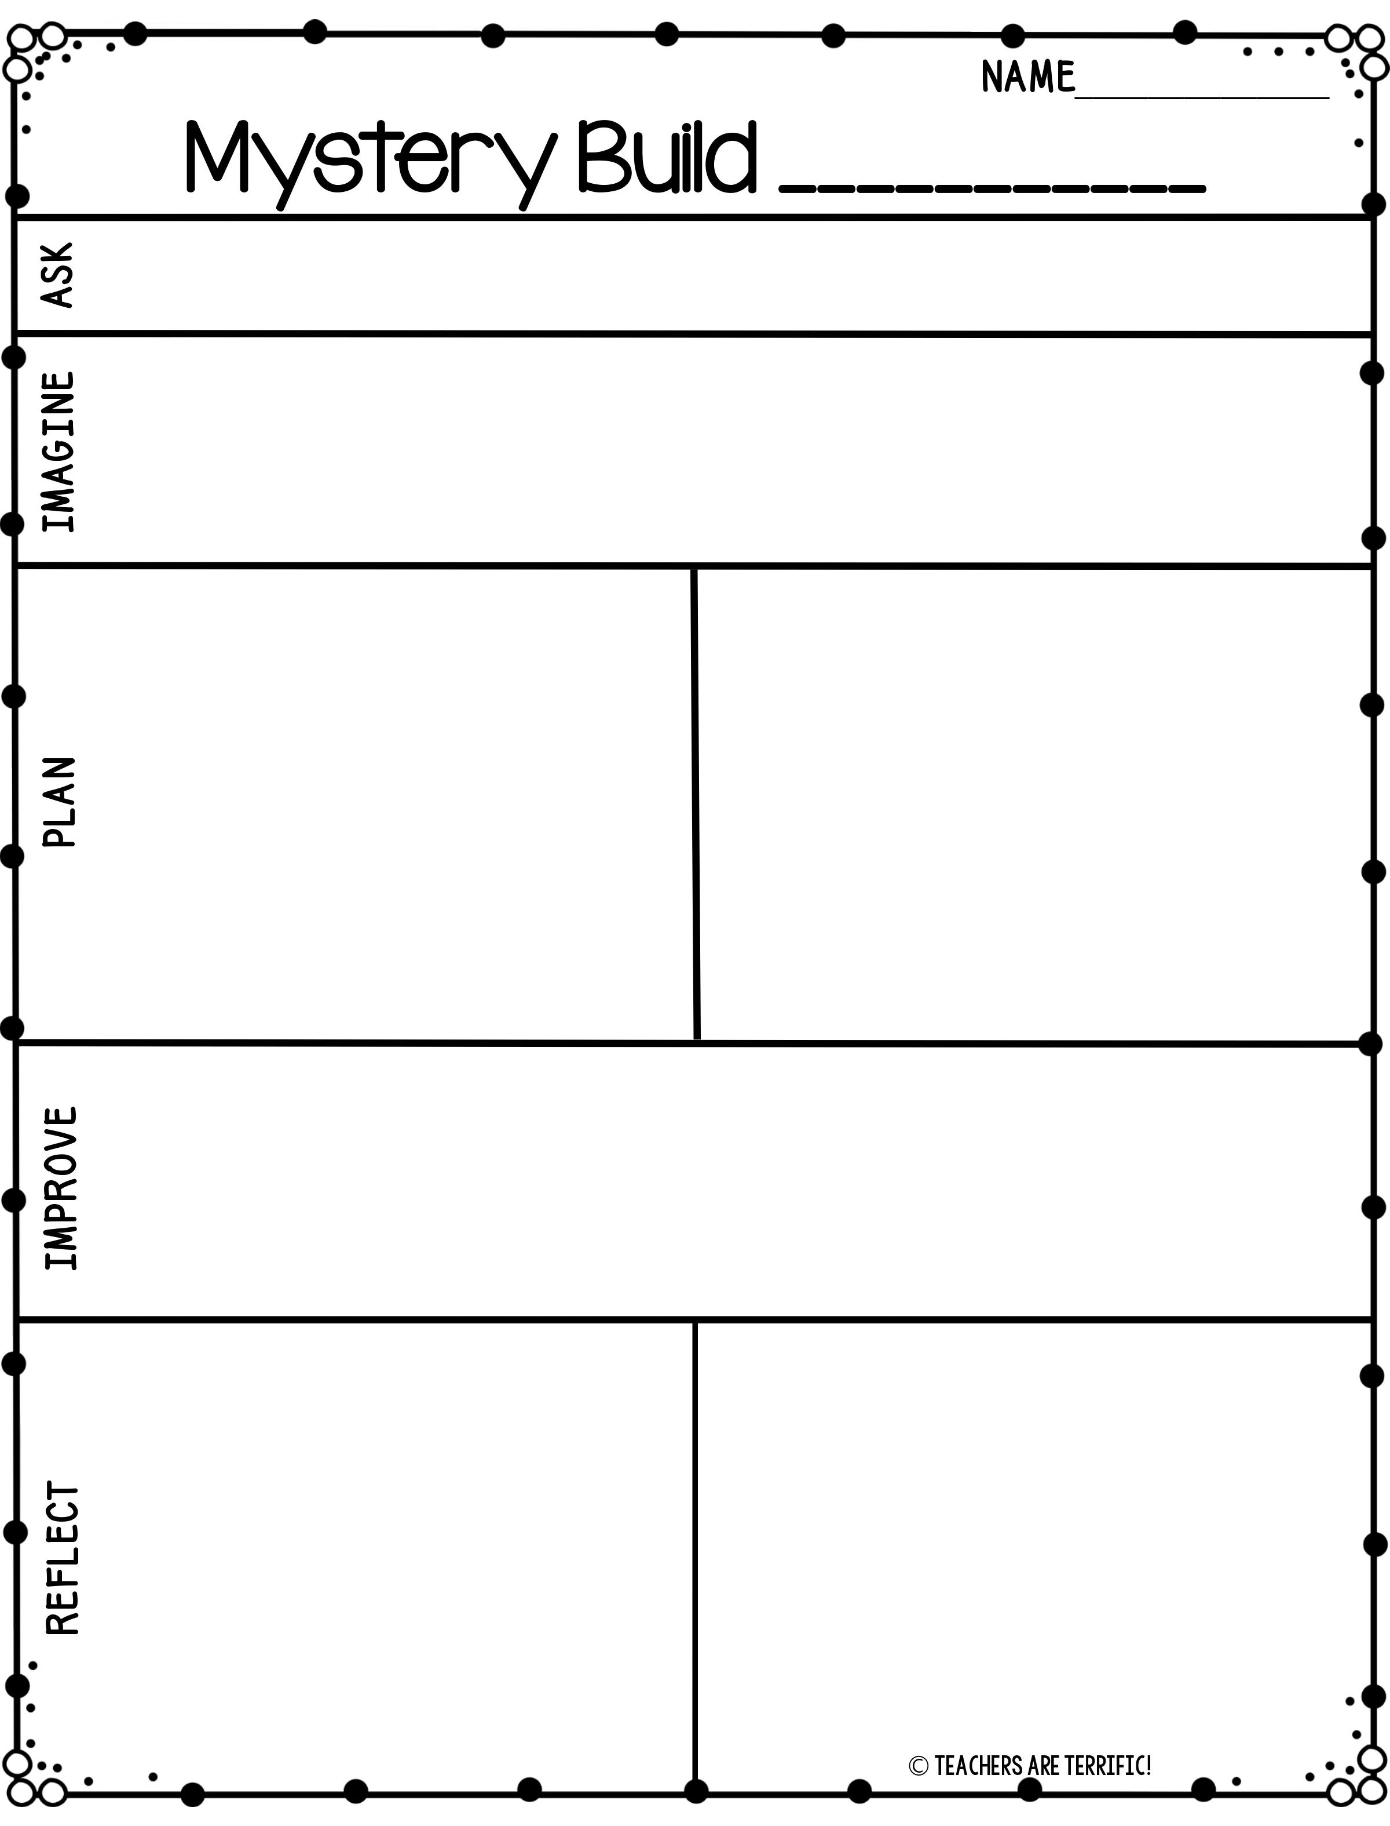
How can you determine which materials to use to build your mystery model? How will you use those materials to successfully complete the structure?
What is the Mystery your team will build? What materials do you think should be chosen and why?
___________________________________________________________________________________________________________________________________________________________________________________________________________________________________________________
CREATE
Sketch and label your idea for structure.
Describe how the structure was built. What was your job on the team?
________________________________________________________________________________________________________________________________________________________________________________________________________________________________________________________________________________________________
Describe some ways you improved your structure as you worked.
_____________________________________________________________________________________________________________________________________________________________________________________________________________________________________________________________________________________________________________________________________________________________________________________________________________________
Was your team successful with choosing the right materials to use for your structure? What did not work as you expected it to?
Describe this building experience. What was the hardest part? What surprised you? What did you learn?
________________________________________________________________________________________________________________________________________________________________________________________________________________________________________________________________________________________
________________________________________________________________________________________________________________________________________________________________________________________________________________________________________________________________________________________

